Slide 1
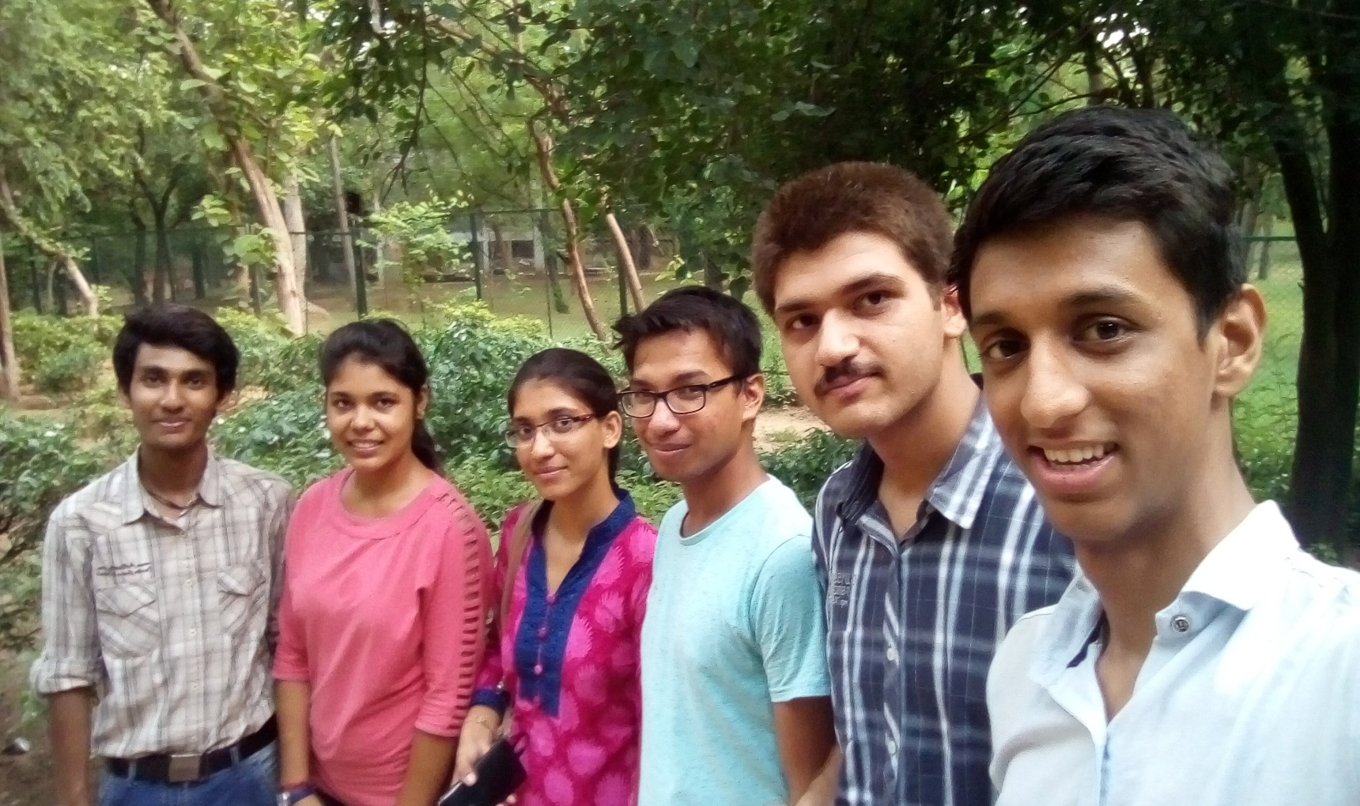
GROUP-1
Class on Creativity and Innovation
NCAT-2016
SHASHANK DHYANI
RITWIK TRIPATHI
AKHIL SHARMA
DANIEL SINHA
VANDANA KUMARI
NEHA SONI

Slide 2
PROBLEM AREAS
People riding vehicles need advanced timers in traffic signals .

Slide 3
Consumers need battery operated heating rods.

Slide 4
Commuters need guidance & directions in unknown areas to avoid cheating and expenses.

Slide 5
MIND MAPPING

Slide 6
FISH BONE DIAGRAM
Material
Measurement
Machine
Limited Smartphone users 17%
Broken taxi meter
Unawareness of distance &time
Limited no of transport facilities
Fraudulent use of meters
exorbitant
Intracity Traveling
fraud
Due to change in weather
Sense of insecurity
Language problem
Unawareness of local environment
all Booked and closed hotels
People
Environment

Slide 7
SIX THINKING HATS
Cost Effective Service
Better Solution in Unfamiliar Environment
Route Direction in User Language
People get cheated if they are unaware about city.
Insecure feeling at unknown places.
Lack of access to technology.
People may be uneducated.

Slide 8
Provide App, Toll free no.
Provide route direction.
Information send via text message.
Cost effective solution.
Feel free from being cheated.
No bad image of visiting place.
Service in their language.

Slide 9
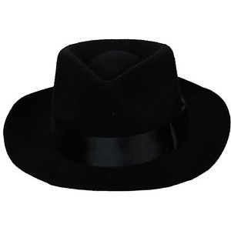
More investment.
Lack of knowledge about the service.
Network failure
Feel more familiar and safe
Easy and convient
More comfortable to reach destination.

Slide 10
SOLUTION
Provide direction to commuters to reach to their destination from a particular place.
Give details about destination distance, time, modes of transportation
Smartphone's as well as ordinary phones receive guidelines in their language.

Slide 11
HOW WILL IT WORK ?
Information from App and Toll Free no.
App gives information through maps.
Toll free no. provide information about destination via sending sms.
Solution provide data about distances between places.
Solution provide routes data.
Solution provide mode of travelling and their charges.

Slide 12
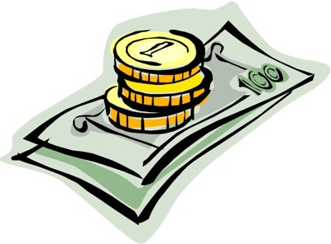
FINANCE
Office set-up.
Technical Support.
Coding and implementation.
Advertisement
Salary
More..

Slide 13
FEASIBILITY
Only 17 % smart phones users in market.
Existing services do not provide appropriate help.
India has a big market of travel and tourism.
Variety of languages spoken across the country.

Slide 14
IMPACT & BENEFITS
Cost effective.
Safe solution to get the right direction.
Useful for all kinds of people
Easy to use
Easy to understand
Traveler feels safe and secure
Commuters don’t lose confidence
Passenger s do not get cheated

Slide 15
HELP NEEDED
FINANCIAL SUPPORT
TECHNICAL KNOW-HOW
GOVERNMENT RECOGNITION
MEDIA SUPPORT

Slide 16
THANK YOU

